Slide 1
CIS 4400
Group 3: Blue Rabbit
Group Members: Elijah Capers, Sunehra Farhana, Nafisa Hasan

Slide 2



Meet the Team!
Elijah Capers
Role: Data Engineer
Sunehra Farhana
Role: Business Analyst
Nafisa Hasan
Role: Business Analyst

Slide 3
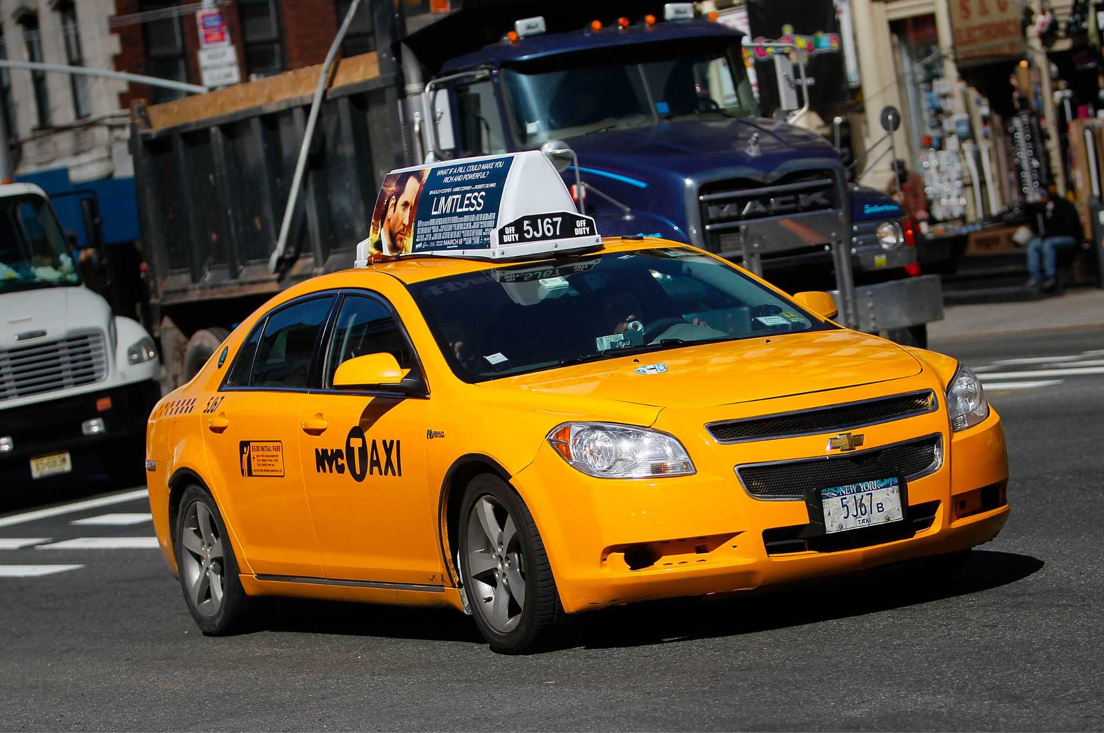
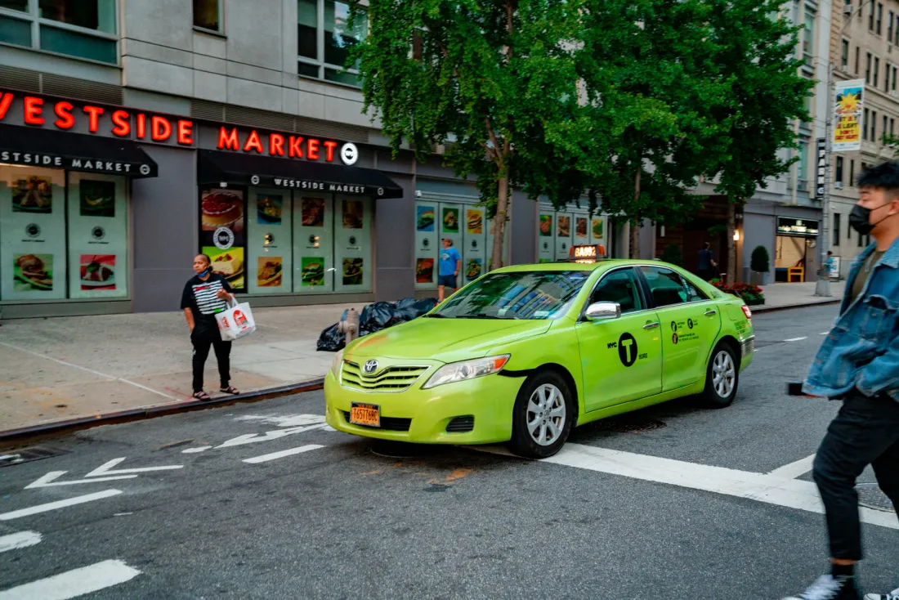
Business Project 4:
Impact of the Green and Yellow Cab in New York City On New York City Traffic while looking at the weather from January 2023 to March 2023

Slide 4
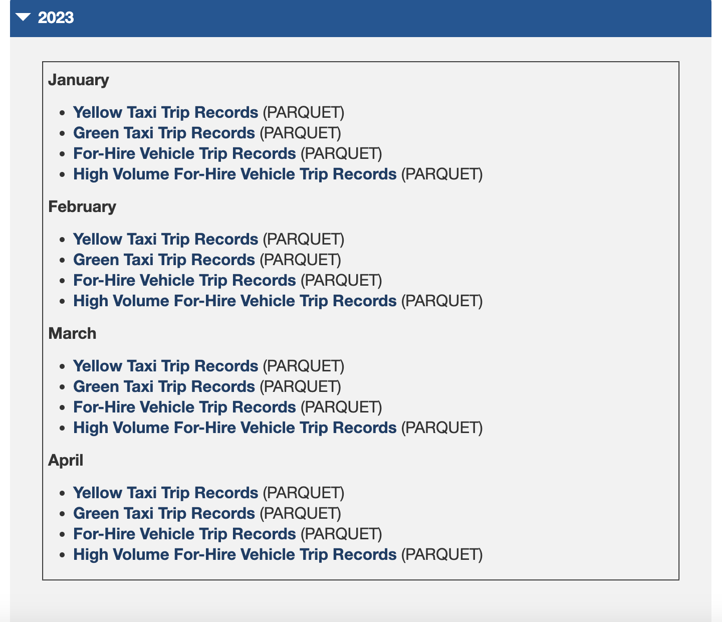
Business Around Project
Our project involves acquiring data from TLC (Taxi & Limousine Commision).
TLC is an agency that controls licensing and regulating New York City's Medallion (Yellow) taxi cabs, and other vehicles such as: community-based (Green) liveries, black cars and luxury limousines, commuter vans, and paratransit vehicles.
It provides data such as the type of taxi, trip distance, and pick-up/drop-off time or location, in the parquet file format.
Fun Fact: “Over 200,000 TLC licensees complete approximately 1,000,000 trips each day” - from About TLC website.

Slide 5
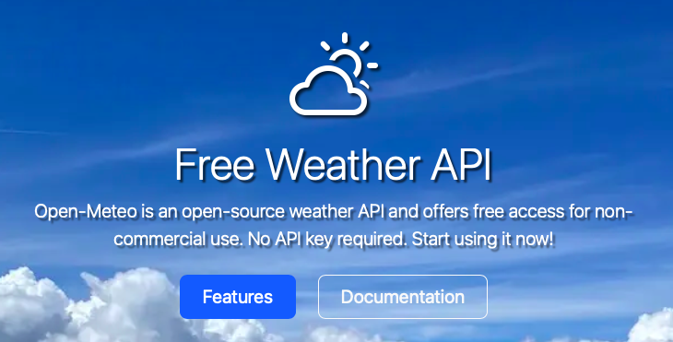
Business Around Project
Our project also acquires data from Open-Meteo, an open-source weather API.
It partners with national weather services to provide historical weather data from any geographical location to the public.
This allowed us to gather information about the temperature, rain, snowfall, and other components to the weather in New York City, within the aforementioned time frame, in the json file format.
We accumulated 10 million rows and 32 columns of data combined.

Slide 6
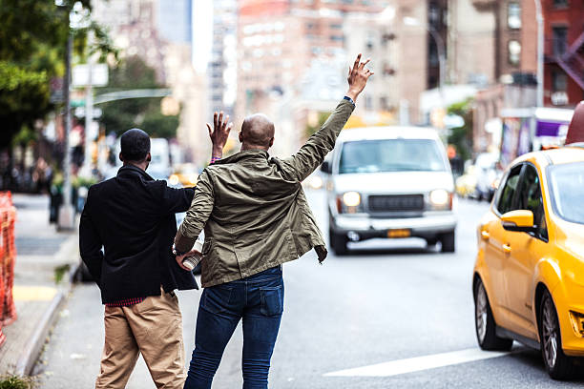
Benefit to Users
The information from this project helps both cab companies and passengers. Users can evaluate the different taxi cab hotspots throughout the boroughs of NYC. The data that we accumulated and analyzed will help the users to find the places that attract the most cab pick-ups and drop-offs. This data will make it easier for people to find a ride efficiently, without the hassle of chasing after a cab. That knowledge will also tell cab companies where they should delegate their resources. More taxi cabs should be sent to patrol the areas with the most pickups, since that’s where most paying passengers would be located.

Slide 7

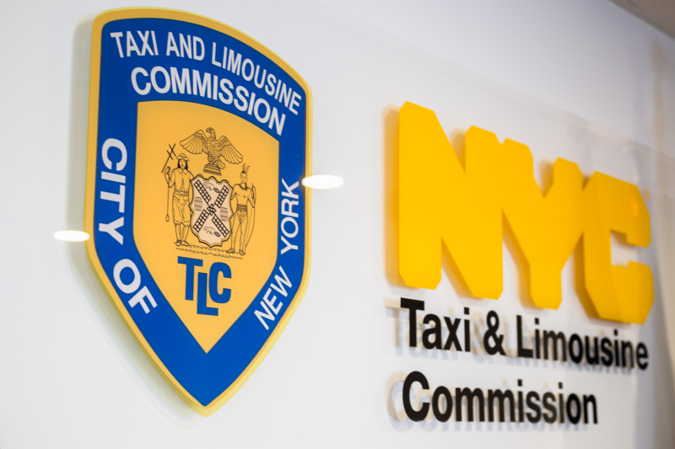

Methodology:
Data Sourcing/Storage
Extracted data logs about green and yellow cabs from the TLC website, and weather API from Open-Meteo.com
Took that data stored it into Microsoft Azure storage
Wrote a Python script in Deep Note to pull taxi data from Microsoft Azure storage
Wrote a Python script in Deep Note to pull weather API based on geographical coordinates

Slide 8
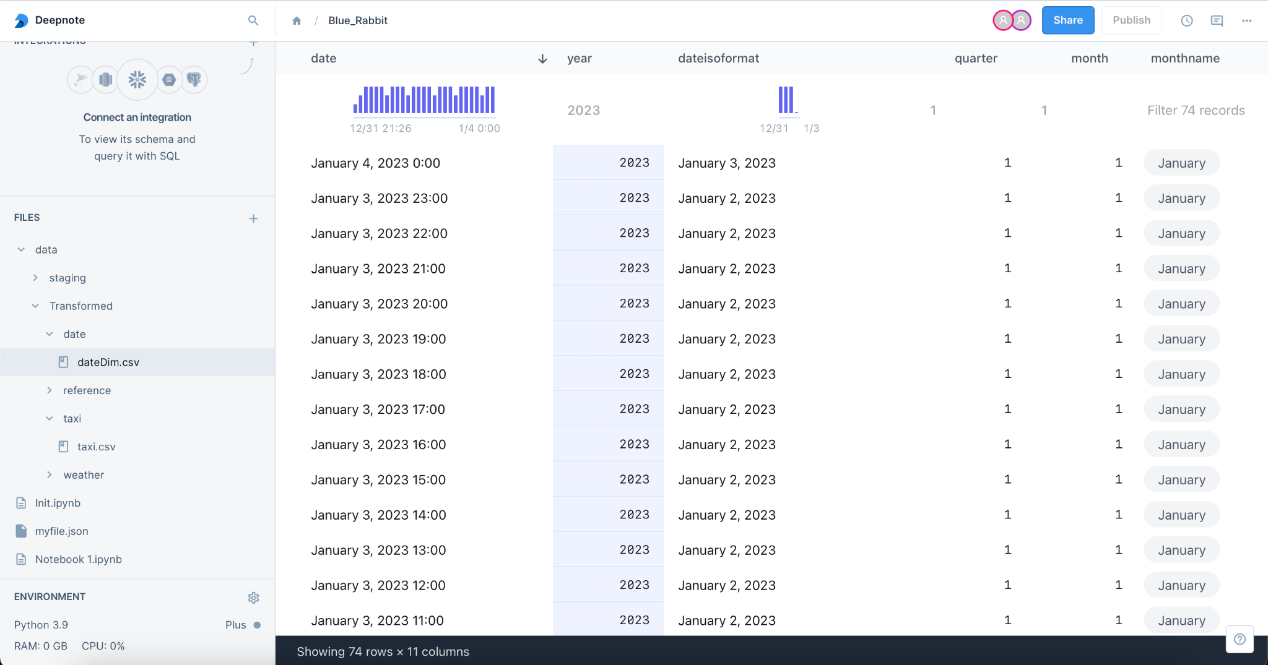
Transformation
Using Deep Note
Imported libraries [ import.sys]
Azure configuration to load dataset
Geo-coding to identify longitude and latitude
Weather API - temperature and weather
Merge green and yellow taxi data into one
Created taxi zone lookup to identify boroughs and zones
Merged geocoding data with taxi zone lookup

Slide 9
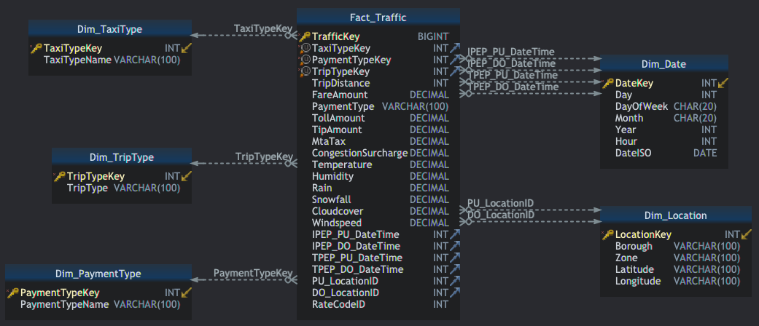
Dimensional Modeling (DbSchema: Create Star Schema)

Slide 10
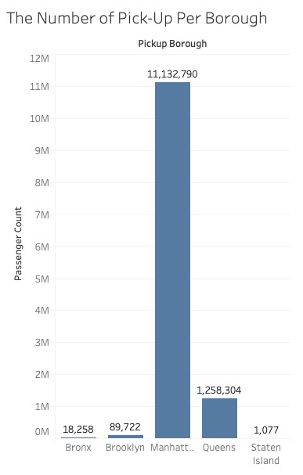
Visualization
Which borough has the most pick-up?
Manhattan, with 11,132,790 passenger count.

Slide 11
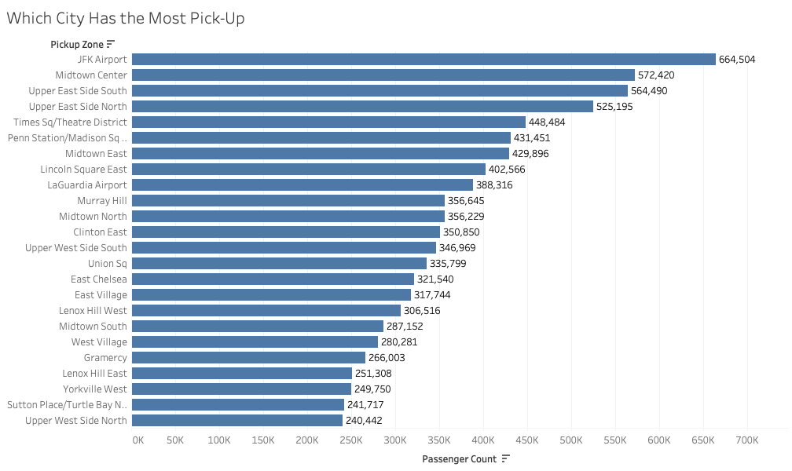
Visualization
Which zone has the most pick-up?
JFK, with 664,504 passenger count.

Slide 12
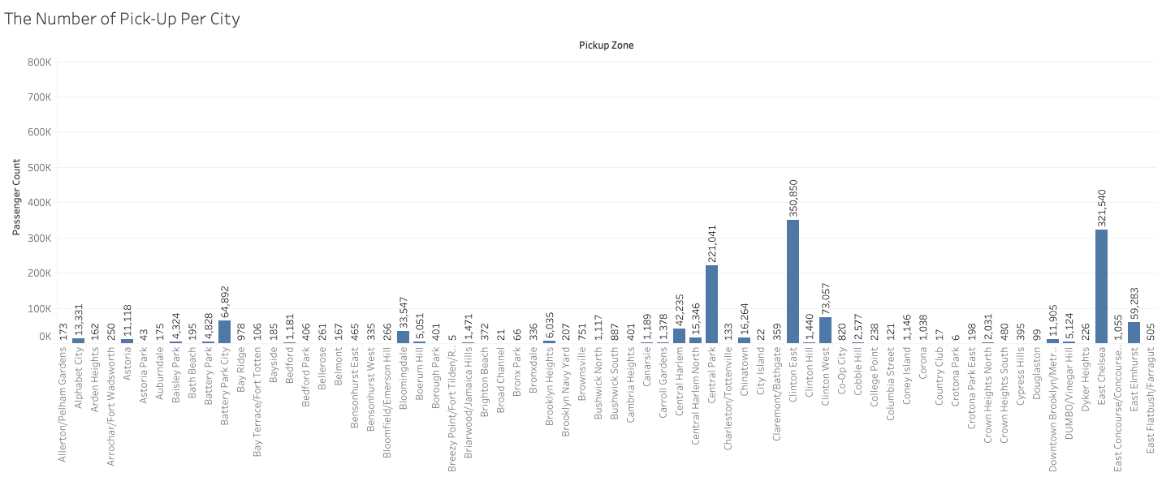
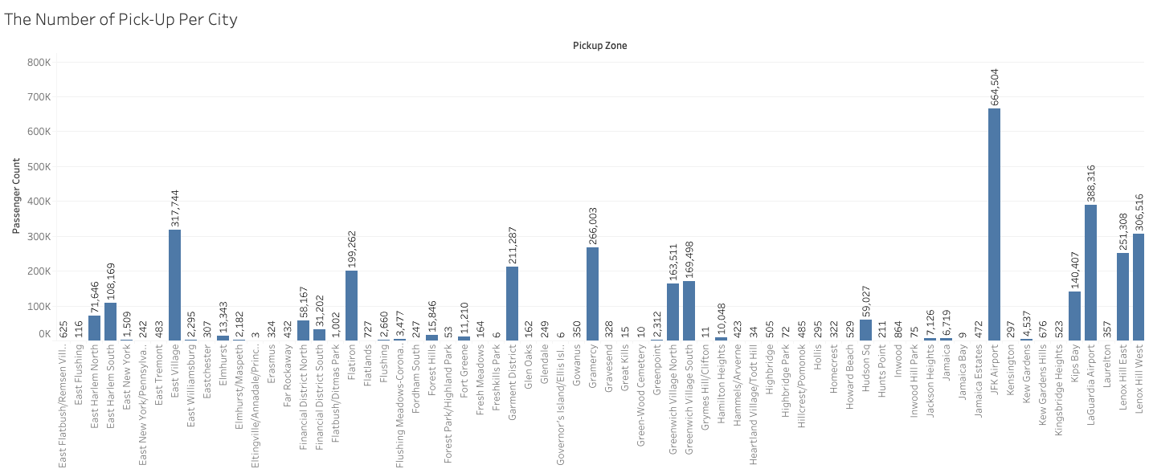
Visualization
What is the number of pick-up in each zone? (Part 1/2)
From Allerton/Pelham Gardens to Yorkville West.

Slide 13
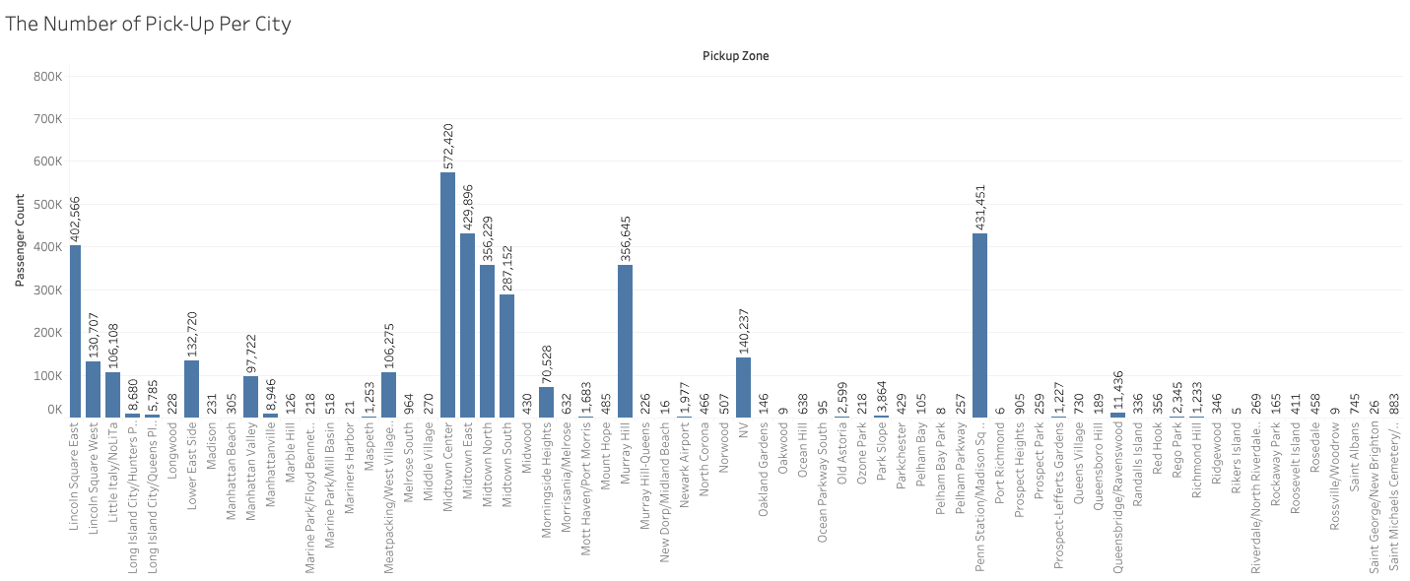
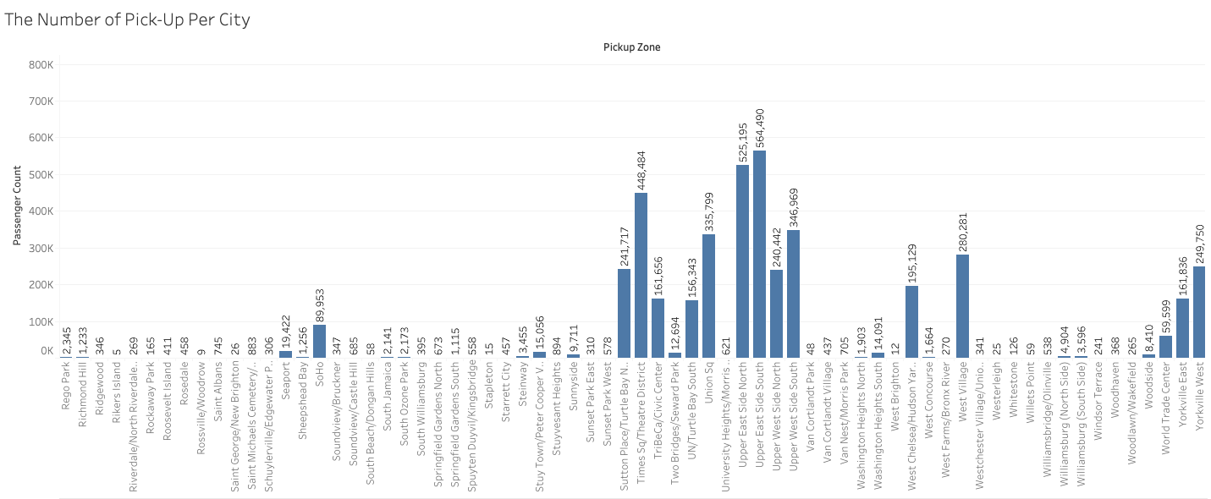
Visualization
What is the number of pick-up in each zone? (Part 2/2)
From Allerton/Pelham Gardens to Yorkville West.

Slide 14
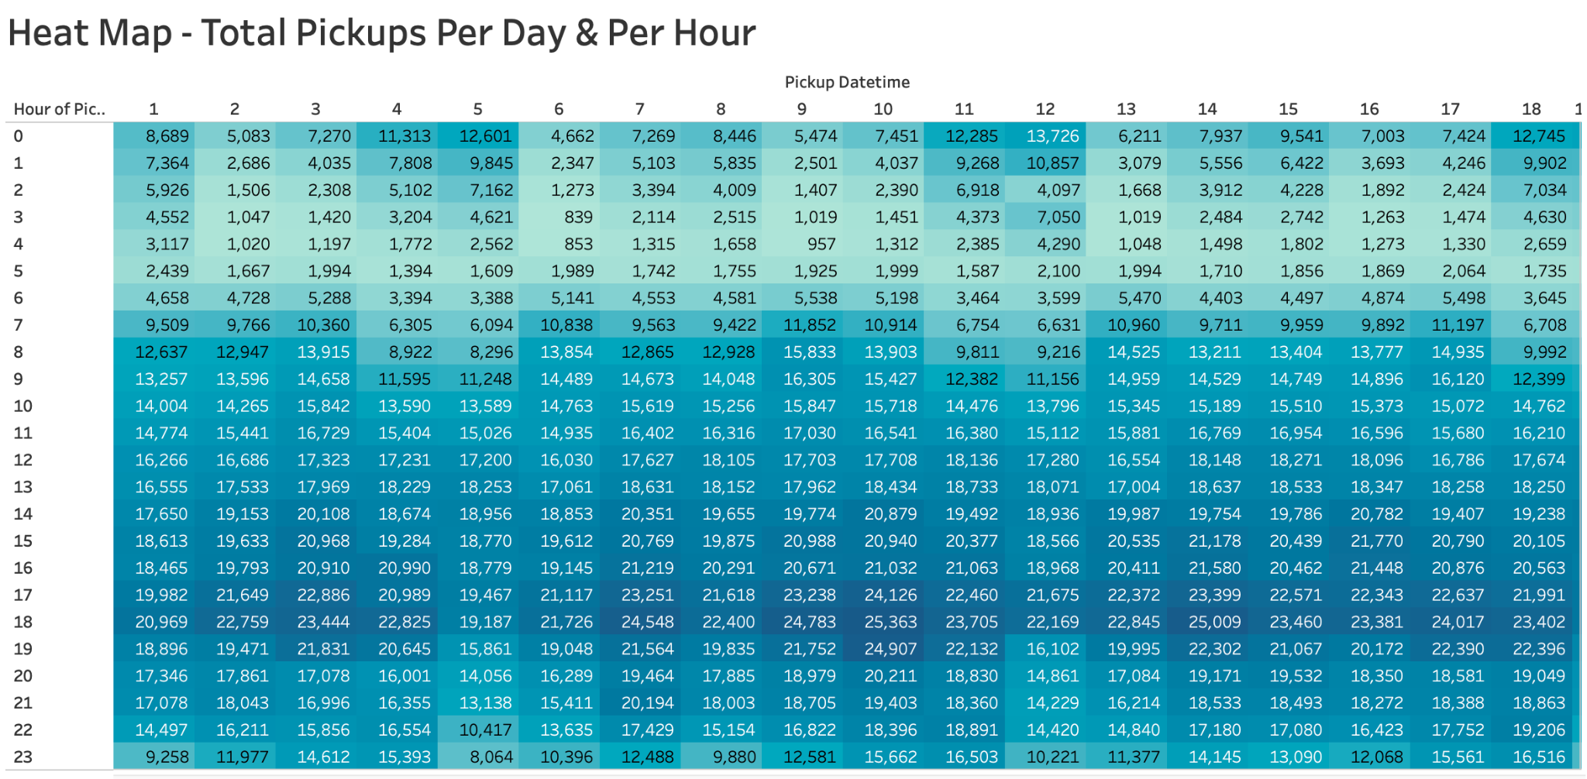
Visualization

Slide 15

Visualization

Slide 16
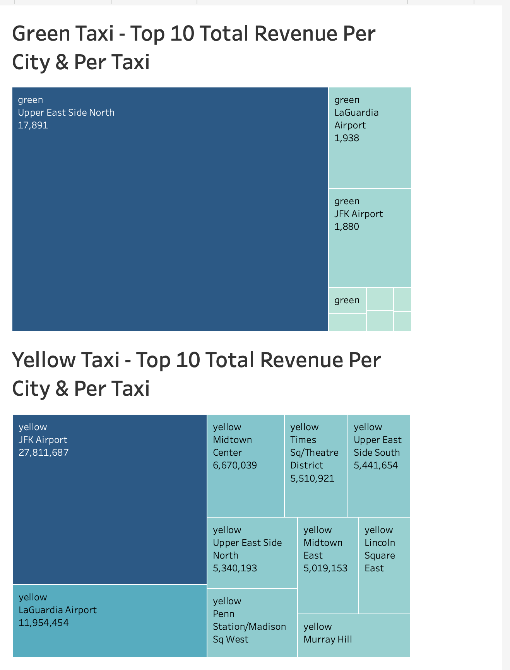
Visualization
Highest Green Taxi Revenue Per City
Upper East Side North
Highest Yellow Taxi Revenue Per City
JFK Airport, Queens

Slide 17
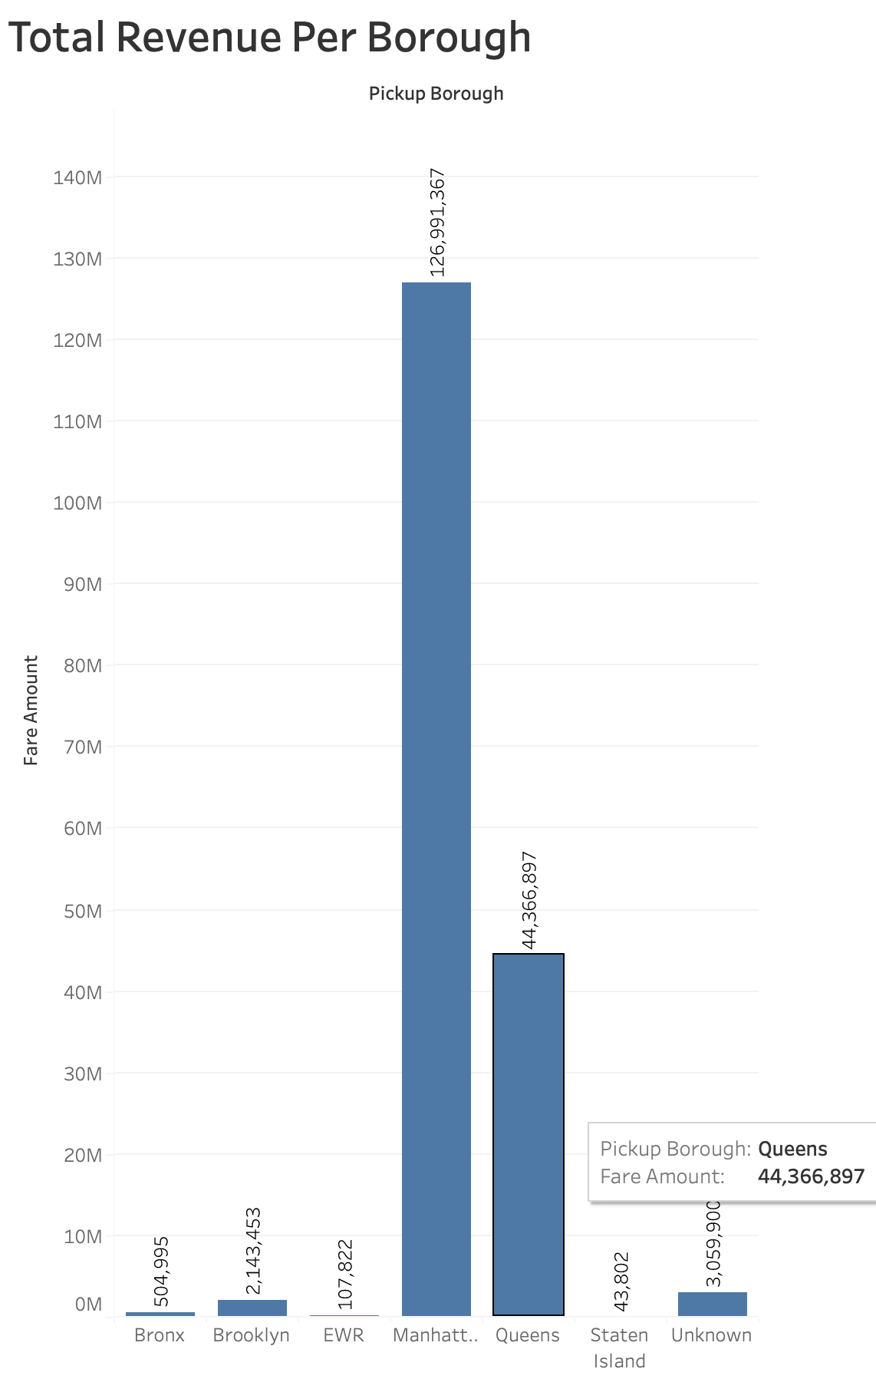
Visualization
Highest Revenue Per Borough
Manhattan

Slide 18

Insight
After looking at the visualizations, it can be determined that JFK is one of zones that is a cab hotspot, with its passenger count totaling 664,504 individuals. Similarly, Manhattan is the borough with the most pickups. This makes sense, given that JFK is an airport and has people coming and going from all parts of the world and Manhattan is a tourist destination.

Slide 19
Future work
For the next iteration of the project, we would like to add the weather data, as well as the drop-off locations. Due to the large file-size, the weather data exceeded Tableu’s capacity. And the drop-off data required a separate data frame needed to be created to store a location id followed by merging both data frames.
The addition of the weather data will allow users to plan ahead of time, adjusting the start-time of their journey according to the state of the weather in their area. For example, if the data demonstrates that on rainy days there are more traffic, it could help users to adjust their schedule to avoid traffic hours.

Slide 20
Final Report
We first started with our Github repository, that enabled us to create a collaborative environment with our group members. We extracted data logs which we then stored it into Microsoft Azure storage. We then used python to create scripts to pull data on the taxis and the weather.
Through this project, we learned a lot about the technical and relational aspects of data. Technically, we learned how to store, accumulate, transform and manipulate data to display and curate the relationship we are trying to distinguish. For example, in this project we got to see the relationships between pickups and boroughs which helped us distinguish local and borough hotspots for taxis/cabs. Similarly, we learned about the relational aspect of data by curating a dimensional model that displays multiple dimensions and facts table. We were able to manipulate data and connect it to other variables that allowed us to see how data is a interconnected resource.

Slide 21
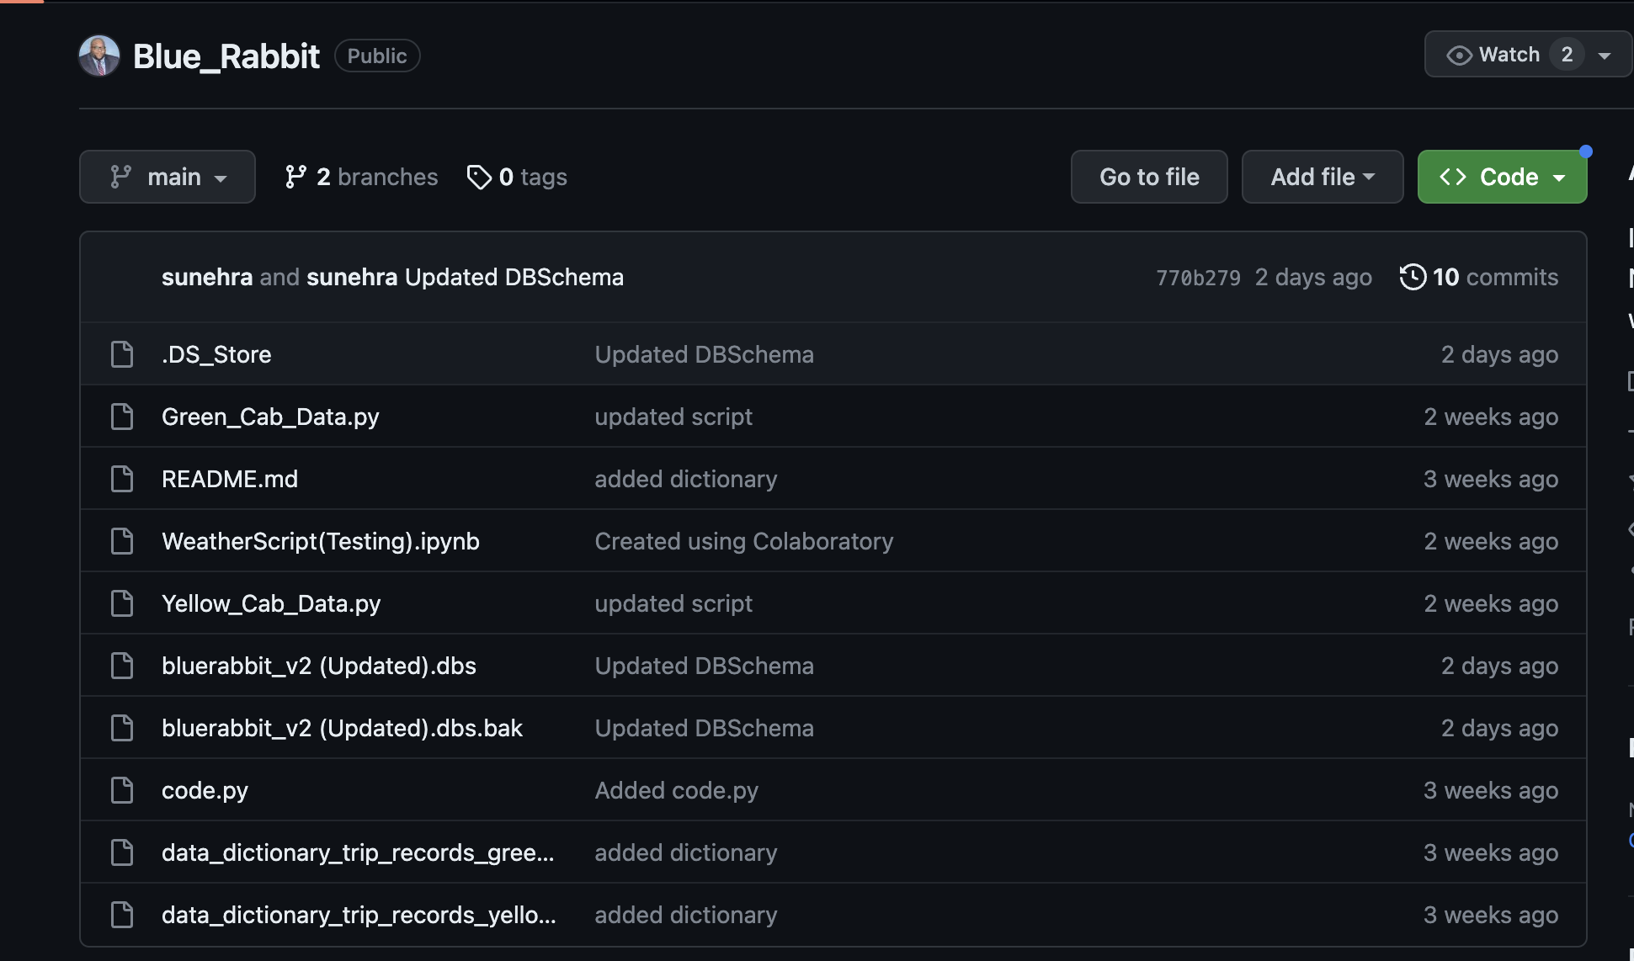
Github Repository

Slide 22
Thank you!

